Slide 1
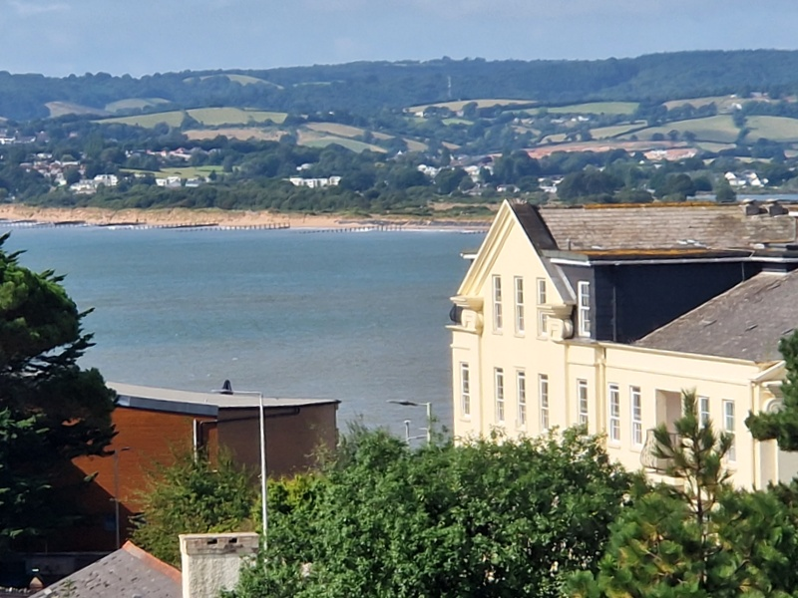
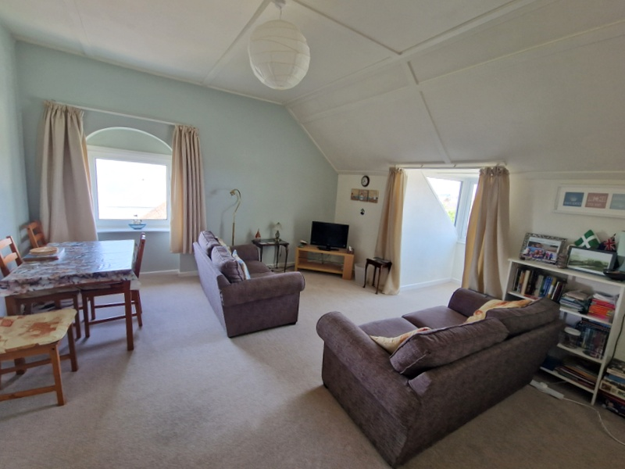
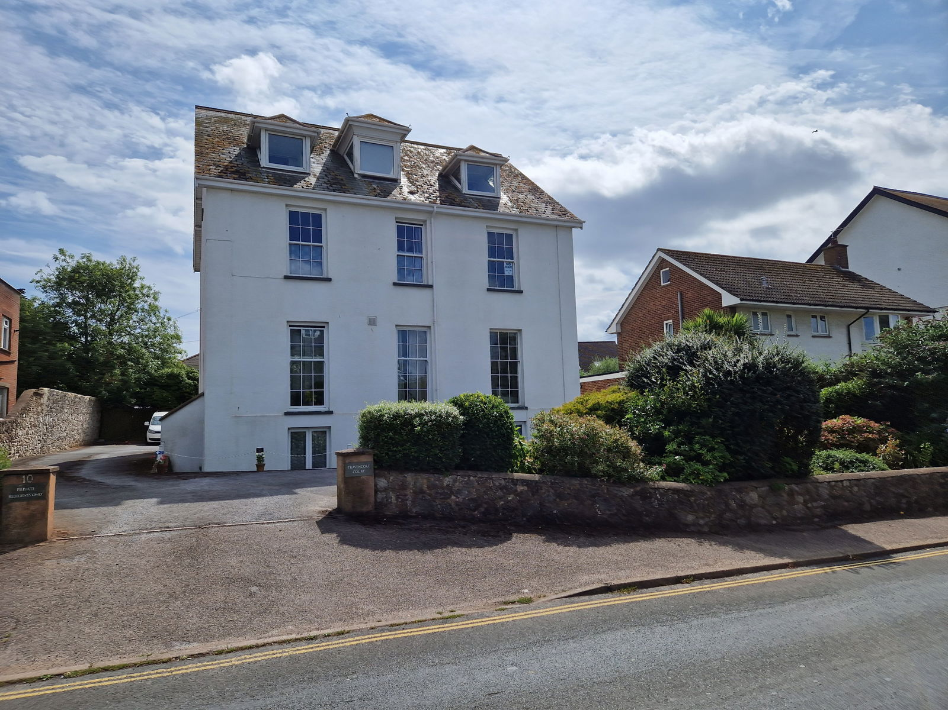
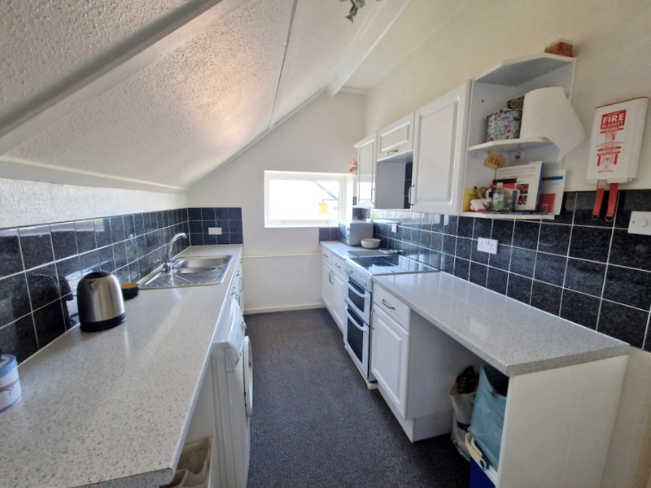
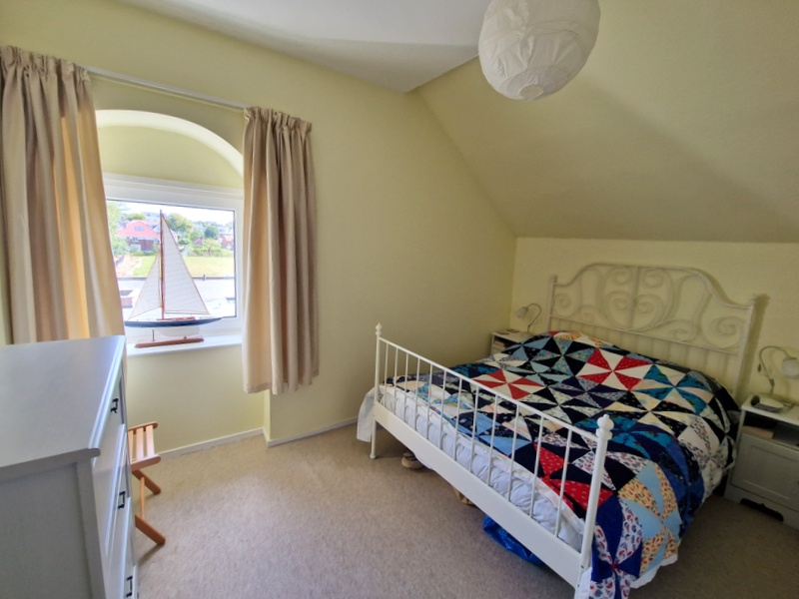
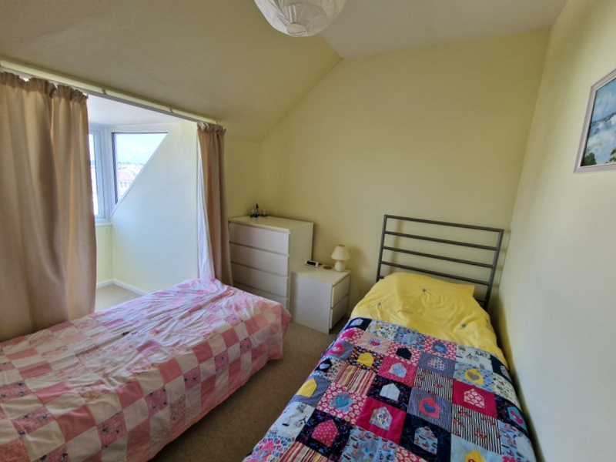
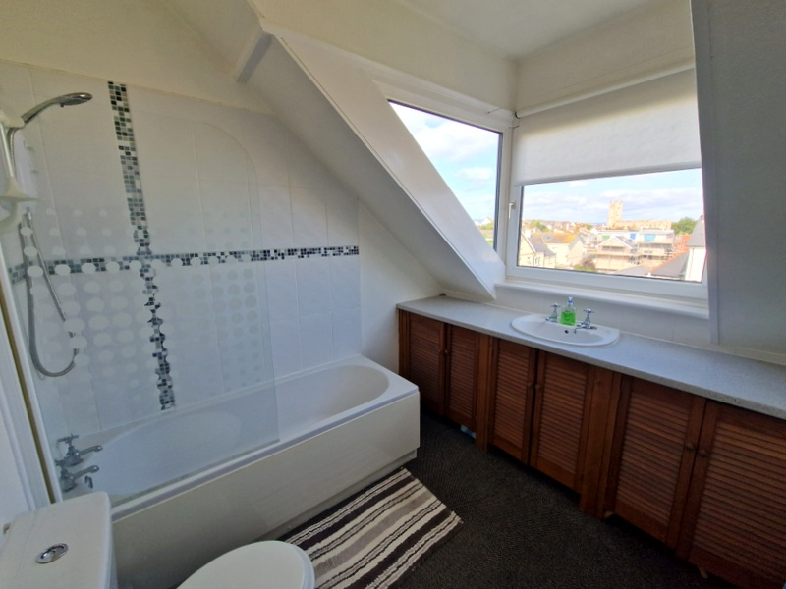
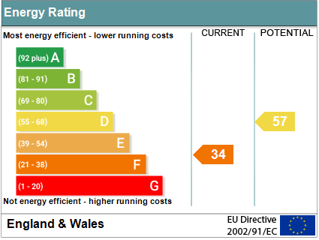
www.pennys.net
Flat 7 Travencore Court, 10 Carlton Hill, Exmouth, EX8 2AJ
GUIDE PRICE £199,950
TENURE Share of Freehold
A Bright And Well Presented Top Floor Flat Enjoying An Enviable Location Just Off The Seafront And Within Walking Distance Of The Town Centre With Allocated Parking Space
Dual Aspect Lounge/Dining Room * Separate Spacious Kitchen * Two Double Bedrooms * Good Size Bathroom/Wc * Pleasant Open Outlook With Views Towards The Estuary, Sea And Coastline Beyond * Ideal Permanent Or Second Home/Holiday Home Retreat * No Onward Chain
Pennys Estate Agents Limited for themselves and for the vendor of this property whose agents they are give notice that:- (1) These particulars do not constitute any part of an offer or a contract. (2) All statements contained in these particulars are made without responsibility on the part of Pennys Estate Agents Limited. (3) None of the statements contained in these particulars are to be relied upon as a statement or representation of fact. (4) Any intending purchaser must satisfy himself/herself by inspection or otherwise as to the correctness of each of the statements contained in these particulars. (5) The vendor does not make or give and neither do Pennys Estate Agents Limited nor any person in their employment has any authority to make or give any representation or warranty whatever in relation to this property.
PENNYS ESTATE AGENTS
2 Rolle House, Rolle Street, Exmouth, Devon, EX8 2SN
Tel: 01395 264111 EMail: help@pennys.net

Slide 2
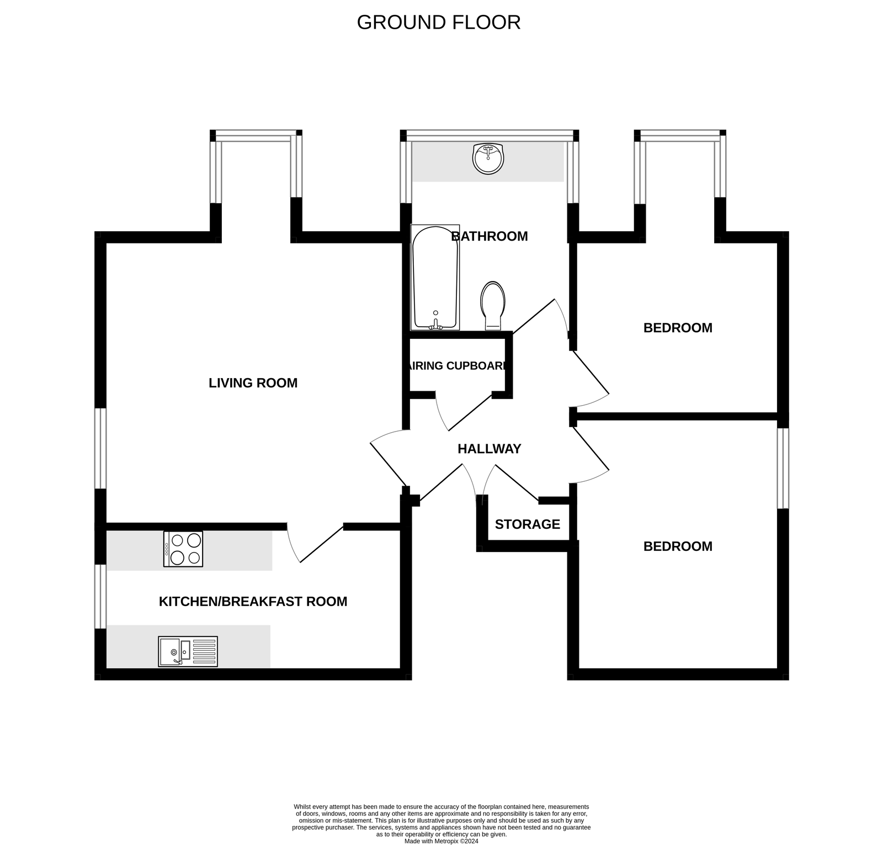
Flat 7 Travencore Court, 10 Carlton Hill, Exmouth, EX8 2AJ
THE ACCOMMODATION COMPRISES: Communal entrance, staircase rising to top floor, private front door giving access to:
RECEPTION HALL: With airing cupboard housing water cylinder and slatted shelving, good size storage cupboard, electric consumer unit.
LOUNGE/DINING ROOM: 4.55m x 4.39m (14'11" x 14'5") plus dormer window recess 1.52m x 1.19m (5'0" x 3'11") Fitted with double glazed windows and gains lovely views towards the estuary, sea and coastline beyond. A bright spacious dual aspect room with further tilt and turn double glazed window to the side elevation, night storage heater and electric convector heater, TV point.
KITCHEN: 4.57m x 2.18m (15'0" x 7'2") A bright room fitted with a range of patterned working surfaces with cupboards, drawer units, plumbing for automatic washing machine and further appliance spaces beneath, electric cooker point, wall mounted cupboards, tiled surrounds, electric night storage heater, uPVC double glazed window enjoying an open aspect.
BEDROOM 1: 3.81m x 3.15m (12'6" x 10'4") Double glazed tilt and turn window, night storage heater.
BEDROOM 2: 3.07m x 2.67m (10'1" x 8'9") plus dormer window recess 1.52m x 1.19m (5'0" x 3'11") Double glazed windows with pleasant open aspect towards the estuary, sea and coastline beyond.
BATHROOM/WC: 2.74m x 2.49m (9'0" x 8'2") A spacious bathroom fitted with wash hand basin set in full width display surface with cupboards beneath, bath with shower unit over, shower splash screen, WC with push button flush, double glazed tilt and turn dormer style window enjoying pleasant open aspect with estuary glimpses, tiling to splash prone areas, dimplex wall fan heater.
OUTSIDE: To the rear of the property there is an allocated parking space. Communal bin store.
TENURE & OUTGOINGS: The property benefits from an equal share of the freehold and together with being held on a healthy long lease. Service Charge is approximately £800 per annum, which includes the building insurance.
AGENTS NOTE: We have been informed by the vendors that no pets are allowed or holiday lets/Airbnb are permitted.
FLOOR PLAN:

